Slide 1
How to make Tic-Tac-Toe

Slide 2
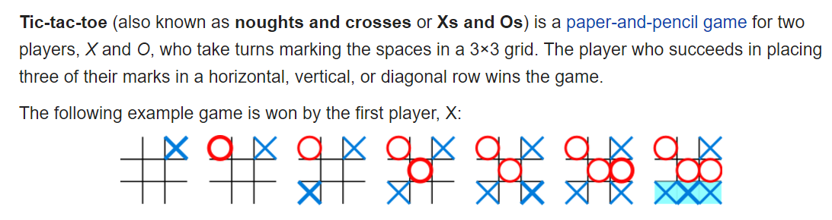
Rules of tic-tac-toe (aka noughts & crosses)

Slide 3
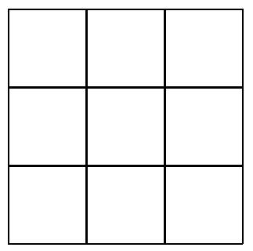
Lets abstract this away a little…
Consider case of just the board by itself

Slide 4
Let’s now further abstract this to just a single box
1) How do we draw just the box itself? What parameters do we need? (Obviously, we should use a class for this!)
2) What state’s can the box have? (i.e. what’s present inside the box)
Blank (i.e. nobody’s clicked on it)
Crosses
Circles
For the latter two, how do we draw these within the box?
3) How do we check if we’ve clicked on this specific box? (Think back to mouse clicks with regards to PyGame)

Slide 5
Now consider how we’ll make a board
Obviously, the board will contain 9 boxes (it’s a 3x3 grid)
How should we store it? What data structure is an obvious candidate?
We need to update the board every time there’s a mouse click. How do we do this? (Hint: look at our PyGame tutorial)
How do we determine if there’s a winner?
These will be broken down in the following slides

Slide 6
Drawing the grid
We want a 3x3 grid => we want 3 rows of 3 identical boxes lined up together. For example, if we used the coordinates (100,100) as the top left corner of the grid, the grid would look like such:
100 pixels
(100,100)
(200,100)
(300,100)
(400,100)
100 pixels
(100,200)
(200,200)
(300,200)
(400,200)
(100,300)
(200,300)
(300,300)
(400,300)
(100,400)
(200,400)
(300,400)
(400,400)

Slide 7
What data structure should we use?
The main data structures that you’ve covered should include as minimum of: dictionaries, lists and multidimensional lists. The former makes most sense (i.e. A 3x3 list).
This multidimensional list should contain the boxes.
Why do we do this?
So that we can treat the board as a single object (as it would be in real life) and individually inspect each square when we get to it.

Slide 8
Updating the board
The board should be updated whenever there’s a mouse click – the board will only be updated if there’s a click in one of the boxes.
How will the board be updated?
At each iteration of the main game loop, you check if the click is in range of any of the boxes (it can only be within a single box).
Update the box as needed (i.e. if it’s already got a value, don’t do anything; if it’s player 1, you enter a cross and if it’s player 2, you enter a circle).

Slide 9
How do we check if there’s a winner?
At each iteration, just brute force all the ways to win in a 3 x 3 grid.
Read here for an over the top way to brute force all the combos:
https://stackoverflow.com/questions/28712279/all-possible-tic-tac-toe-winning-combinations

